Slide 1
Super Nintendo Entertainment System (SNES) Controller
Jalal Kawash

Slide 2
Outline
SNES controller

Slide 3
SNES Controller
Section 1

Slide 4
Section 1 Objectives At the end of this section you will
Understand the communication protocol of the SNES controller
Write programs to interact with the SNES controller

Slide 5
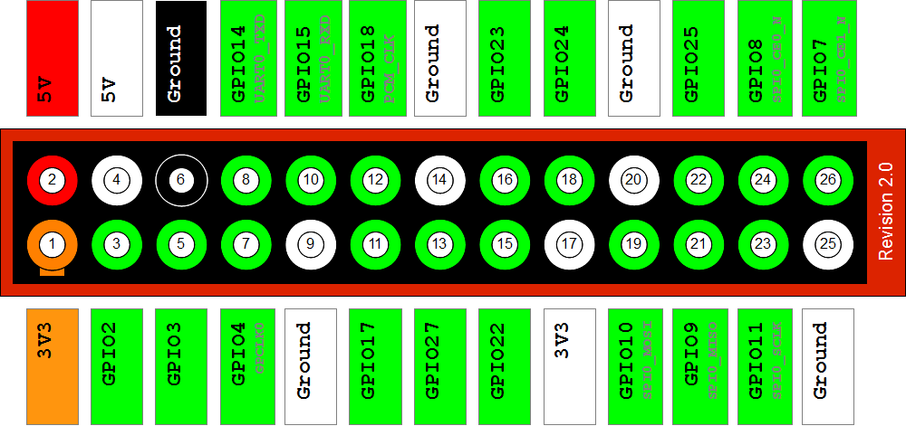
GPIO SNES Pins
DAT
LAT
CLK
www.raspberrypi-spy.co.uk

Slide 6
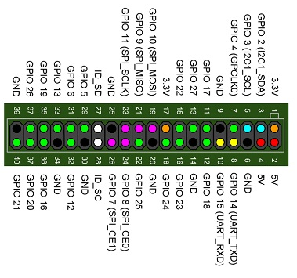
Ebay.com

Slide 7
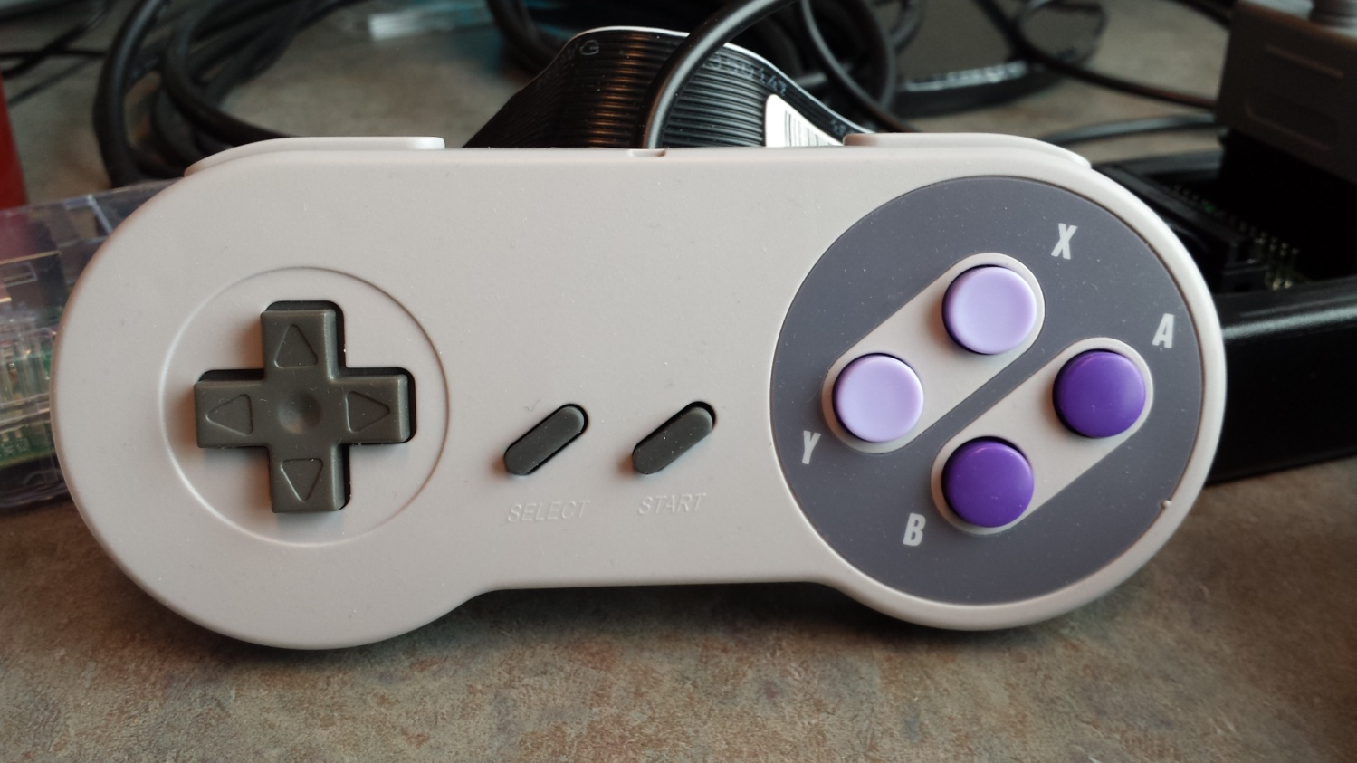
The Controller

Slide 8
SNES Button Numbers
Clock Cycle Button Reported =========== =============== 1 B 2 Y 3 Select 4 Start 5 Up on joypad 6 Down on joypad 7 Left on joypad 8 Right on joypad 9 A 10 X 11 L 12 R 13 none (always high) 14 none (always high) 15 none (always high) 16 none (always high)
Button Number/ Clock Cycle | Button
1 | B
2 | Y
3 | Select
4 | Start
5 | Joy-pad UP
6 | Joy-pad DOWN
7 | Joy-pad LEFT
8 | Joy-pad RIGHT
9 | A
10 | X
11 | Left
12 | Right
13-16 | Unused – for future use (always high)

Slide 9

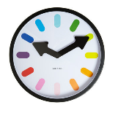

SNES Lines
LATCH: latch line
Used by the core to instruct the controller to latch the state of the buttons internally
Which buttons on the controller are pressed
CLOCK: clock line
The core sends a clock signal of 16 intervals
One for each button
Interval 1 is for Button B; 2 for Y etc …
DATA: data line
Controller sends serial signal to core indicating which buttons are pressed

Slide 10
Recall GPFSEL{n}
GPIOFSEL{n}
30-31
27-29
24-26
21-23
18-20
15-17
12-14
9-11
6-8
3-5
0-2
reserved
Pin
{n}9
Pin
{n}8
Pin
{n}7
Pin
{n}6
Pin
{n}5
Pin
{n}4
Pin
{n}3
Pin
{n}2
Pin
{n}1
Pin
{n}0

Slide 11
Initializing SNES – CLOCK line
Set GPIO pin 11 (CLK) to output
#define CLK 11
#define LAT 9
#define DAT 10
INP_GPIO( CLK );

Slide 12
Initializing SNES
Similarly,
Set GPIO pin 9 (LATCH) to output
Set GPIO pin 10 (DATA) to input (code 0)
INP_GPIO( LAT );
OUT_GPIO( LAT );
INP_GPIO( DAT );

Slide 13
#define GPIO_BASE 0x3F200000
static unsigned *gpio = (unsigned*)GPIO_BASE; // GPIO base
// GPIO setup macros. Always use INP_GPIO(x) before using OUT_GPIO(x) or SET_GPIO_ALT(x,y)
#define INP_GPIO(g) *(gpio+((g)/10)) &= ~(7<<(((g)%10)*3))
#define OUT_GPIO(g) *(gpio+((g)/10)) |= (1<<(((g)%10)*3))
#define SET_GPIO_ALT(g,a) *(gpio+(((g)/10))) |= (((a)<=3?(a)+4:(a)==4?3:2)<<(((g)%10)*3))
#define CLK 11
#define LAT 9
#define DAT 10
void initSNES() {
INP_GPIO( CLK ); // CLK
OUT_GPIO( CLK );
INP_GPIO( LAT ); // LATCH
OUT_GPIO( LAT );
INP_GPIO( DAT ); // DATA
}

Slide 14
Communication Protocol
LATCH is used to instruct the SNES to sample and latch buttons
Which buttons are pressed
Latched in a register
CLOCK line is used to synchronize serial signal sent from SNES to the core
DATA line is used to read the serialized latched register representing button sampling

Slide 15
Communication Protocol (1) Core Asks for a report on buttons
Core
SNES
12μs
LATCH
LATCH
CLOCK
CLOCK
DATA
DATA

Slide 16
Communication Protocol (2) SNES Samples Buttons
Sampling buttons = creating a register representation of which buttons are pressed
One bit for each button is sufficient
Example: 1111101111100
Three buttons are pressed (buttons 0, 1, & 7)

Slide 17
Communication Protocol (3) Core pulses clock; SNES to sends report
Core
SNES
12μs
LATCH
LATCH
CLOCK
6μs
CLOCK
B
Y’
Sl
St
⬆’
⬇’
⬅’
➔
DATA
DATA

Slide 18
Communication Protocol (3) Core pulses clock; SNES to sends report
Pulsing continues for 16 times
SNES has 12 buttons
First 12 pulses sample the buttons
Last 4 pulses are not used (always 1)
Reserved for future extensions

Slide 19
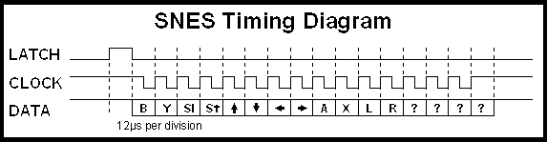
Communication Protocol (3)
From: homepages.inf.ed.ac.uk

Slide 20
Reading from SNES
MOV buttons, #0 // register sampling buttons
writeGPIO(CLOCK,#1)
writeGPIO(LATCH,#1)
wait(12μs) // signal to SNES to sample buttons
writeGPIO(LATCH,#0)
pulseLoop: // start pulsing to read from SNES
i = 0
wait(6μs)
writeGPIO(CLOCK,#0) // falling edge
wait(6μs)
readGPIO(DATA, b) // read bit i
buttons[i] = b
writeGPIO(CLOCK,#1) // rising edge; new cycle
i++ // next button
if (i < 16) branch pulseLoop

Slide 21
One iteration
16 iterations of pulseLoop

Slide 22
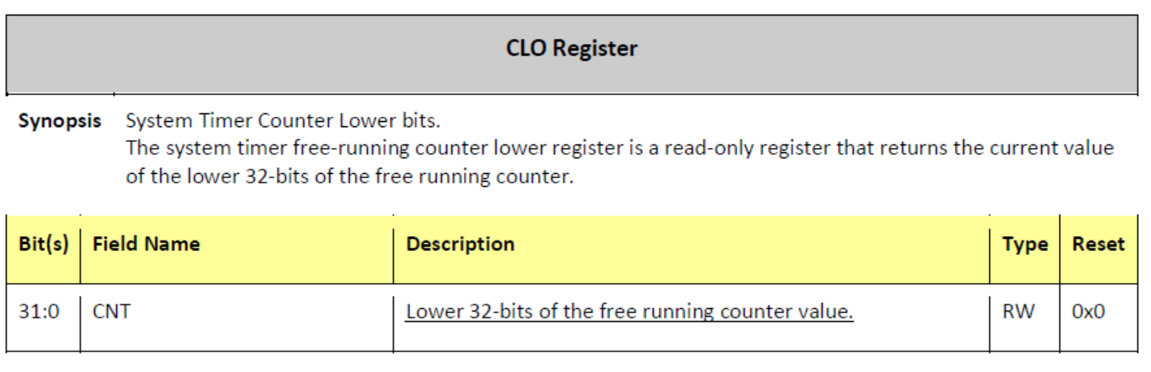
System Timer
Address: 0x3F003004
CHI is the next register, containing the higher 32-bits

Slide 23
Waiting
#define CLO_REG 0x3F003004
unsigned *clo = (unsigned*)CLO_REG;
unsigned c = *clo + 12; \\ micro Secs
while (c > *clo);

